Slide 1

“A Robust Image Steganography Framework Using Edge Detection and CNN for Secure Data Hiding”
Batch No: A3-11
MURALI REDDY LAVANYA 22102A040178
PATNAM NITHIN 22102A040204
REDDY VARI TEJA REDDY 22102A040226
SHAIK MOHAMMAD TAYEEB 22102A040246
Under the Guidance of Dr.K. Hari Krishna Associate Professor, CSE
Department of Computer Science and Engineering School of Computing
Mohan Babu University
Sree Sainath Nagar, A. Rangampet, Tirupati – 517 102
2022-2026

Slide 2
Table of Contents
Abstract
Introduction
Problem Statement
Objectives
Applications
Literature Survey & Research Gaps Identified
Proposed System Design
Dataset Description
Software and Hardware Components
Performance Evaluation
Conclusion
References

Slide 3
Abstract
Steganography has emerged as an effective technique for secure communication, where secret data is concealed within digital images to prevent unauthorized access. However, conventional methods such as Least Significant Bit (LSB) substitution suffer from low robustness, reduced security, and high vulnerability to detection through steganalysis. These limitations make traditional steganography unsuitable for modern secure communication, especially when images undergo common processing operations such as compression, noise addition, and filtering.
To overcome these challenges, this project proposes a robust image steganography framework that integrates edge detection with Convolutional Neural Networks (CNN). Edge detection is applied to the cover image to identify high-frequency regions where embedding is less noticeable to the Human Visual System (HVS). A CNN model is then used to optimize both embedding and extraction by learning suitable pixel positions and minimizing distortion. Experimental evaluation shows high PSNR and SSIM values for maintaining visual quality, along with low BER for accurate data recovery, confirming that the proposed approach achieves a strong balance between imperceptibility, robustness, and security.

Slide 4
Introduction
In the modern digital era, secure communication has become a major concern due to the rapid growth of internet usage and the frequent sharing of multimedia data. Images are one of the most commonly exchanged forms of digital content through social media, cloud platforms, and communication networks, making them an ideal medium for hiding confidential information. Unlike encryption, which makes the presence of secret data obvious, steganography hides information inside images in such a way that it remains invisible to unauthorized users.
Traditional image steganography techniques such as Least Significant Bit (LSB) embedding are widely used because they are simple and provide good visual quality. However, these methods are weak in terms of robustness and security, as they can be easily detected using steganalysis and the hidden data may be destroyed when the image undergoes compression, noise, or filtering. To overcome these limitations, this project proposes a robust image steganography framework that combines edge detection and Convolutional Neural Networks (CNN). Edge detection helps identify high-frequency regions where embedding is less noticeable, while CNN improves the embedding and extraction process by learning optimal pixel locations, resulting in improved imperceptibility, robustness, and secure data recovery.

Slide 5
Problem Statement
Traditional image steganography techniques such as LSB embedding do not provide a proper balance between security, imperceptibility, and robustness.
These methods are easily detectable through steganalysis, making hidden communication insecure.
The hidden data can be lost or corrupted when the stego image undergoes common image processing operations such as JPEG compression, noise addition, and filtering.
Uniform embedding across the image may create noticeable distortion, reducing the visual quality of the stego image.
Hence, there is a need for a robust and intelligent steganography framework that uses edge detection to select suitable embedding regions and CNN to optimize embedding and extraction while maintaining high image quality and strong attack resistance.

Slide 6
Objectives
The Primary objective is To design and develop a robust image steganography framework for secure data hiding in digital images, ensuring that the secret information remains confidential and the stego image appears visually similar to the original cover image..
To apply edge detection techniques such as Canny, Sobel, and HED (Holistically Nested Edge Detection) to identify high-frequency edge regions, because embedding in these regions is less noticeable to the Human Visual System (HVS) and improves imperceptibility.
To integrate a CNN-based encoder–decoder model to optimize the embedding and extraction process, by automatically learning suitable pixel positions, reducing embedding distortion, and improving the accuracy of recovering the hidden message from the stego image.
To improve the system’s imperceptibility and visual quality by minimizing visible distortion in the stego image and achieving higher performance in terms of PSNR (Peak Signal-to-Noise Ratio) and SSIM (Structural Similarity Index) compared to traditional steganography methods.
To ensure strong robustness and security by making the hidden data resistant to common image processing operations such as JPEG compression, noise addition, and filtering, while maintaining low BER (Bit Error Rate) and improving resistance against steganalysis detection techniques..

Slide 7
Applications
Secure Communication
Hiding confidential messages within images for safe transmission over public networks.
Military & Defense
Used for covert communication and secure exchange of sensitive information.
Banking & Financial Security
Protecting transaction details, credentials, and sensitive financial data.
Data Privacy & Protection
Safeguarding personal data such as medical records, legal documents, and identity information.
Digital Watermarking & Copyright Protection
Embedding ownership information in images to prevent unauthorized use.
Cybersecurity Applications
Preventing data leakage by hiding information in seemingly harmless files.
Secure Cloud Storage
Storing sensitive data inside images before uploading to cloud platforms.
Confidential Document Transmission
Sending classified information without attracting attention.

Slide 8
Literature Survey
S. No | Year | Authors | Title | Outcomes
1 | 2025 | Al-Rawashdeh, Rahman & Niazi | Robust Image Steganography Approach Based on Edge Detection Combined with CNN Algorithm | Improved imperceptibility and robustness using edge regions + CNN based embedding and extraction.
2 | 2021 | Ray, Banerjee & Bandyopadhyay | Image Steganography Using Deep Learning Based Edge Detection | Edge-aware deep learning improves secure embedding and reduces detectability
3 | 2020 | Liu, Tang & Luo | Secure and Robust Image Steganography Based on Convolutional Neural Networks | CNN improves embedding optimization and accurate recovery of hidden data.
4 | 1986 | Canny | A Computational Approach to Edge Detection | Introduced Canny edge detection, useful for identifying high-frequency regions for hiding data.
5 | 2018 | Hussain et al. | A Survey of Image Steganography Techniques | Highlights that LSB methods are simple but weak against compression, noise, and steganalysis.

Slide 9
Cont…
S. No | Year | Authors | Title | Outcomes
6 | 2025 | Zhang, Ji & Lv | Edge-Guided Dual-Stream U-Net for Secure Image Steganography | Deep U-Net based edge-guided model gives high-quality stego images and accurate extraction.
7 | 2023 | Sultana et al. | Hybrid Edge Detection and LBP Code-Based Robust Image Steganography Method | Combines edge + texture features to improve security and imperceptibility.
8 | 2025 | Almuhammadi et al. | Secure Edge-Guided Adaptive Image Steganography Using HED-Based Attention Maps and CNN | HED attention maps + CNN improve adaptive embedding and robustness.
9 | 2024 | Habiban,Hamad & Mohsin | Hybrid Edge Detection Methods in Image Steganography for High Embedding Capacity | Hybrid edge detection improves embedding capacity while maintaining good PSNR/SSIM.
10 | 2025 | Singh & Singh | Improved Edge-Based Image Steganography Using Segmentation and Random LSB Substitution | Random edge embedding improves security compared to standard LSB.

Slide 10
Research Gaps
Traditional LSB-based Steganography is simple but it is weak against steganalysis and fails when the image undergoes compression, noise addition, or filtering.
Many existing steganography methods embed data uniformly across the image without selecting the best regions, which increases distortion and makes hidden data easier to detect.
Even though edge-based embedding improves imperceptibility, classical edge detection methods are rule-based and do not adapt well to different image types, textures, and complexities.
Several deep learning (CNN) based approaches improve embedding and extraction, but without edge guidance, CNN models may still cause distortion in smooth regions and reduce invisibility.
The biggest research gap remains achieving an effective balance between:
Payload Capacity
Imperceptibility (PSNR, SSIM)
Robustness (BER under attacks)
Security (resistance to steganalysis)
Most existing methods do not support adaptive embedding strength based on image complexity, which affects capacity and invisibility.

Slide 11
Proposed System
The proposed system develops a robust image steganography framework using Edge Detection and CNN for secure data hiding.
The cover image is processed using edge detection techniques (Canny / Sobel / HED) to identify high-frequency edge regions where embedding is less noticeable to the Human Visual System (HVS).
An edge-based attention map (embedding mask) is generated to select suitable embedding locations.
The secret message is encrypted and randomized before embedding to improve security.
A CNN Encoder (Hiding Network) adaptively embeds the secret data mainly into edge regions while minimizing distortion and maintaining image quality.
The output produced is a stego image that looks almost identical to the original cover image.
At the receiver side, a CNN Decoder (Revealing Network) extracts the hidden message accurately from the stego image.
The system is evaluated using PSNR, SSIM, and BER to ensure high imperceptibility, robustness, and reliable extraction even after compression, noise, and filtering attacks.

Slide 12
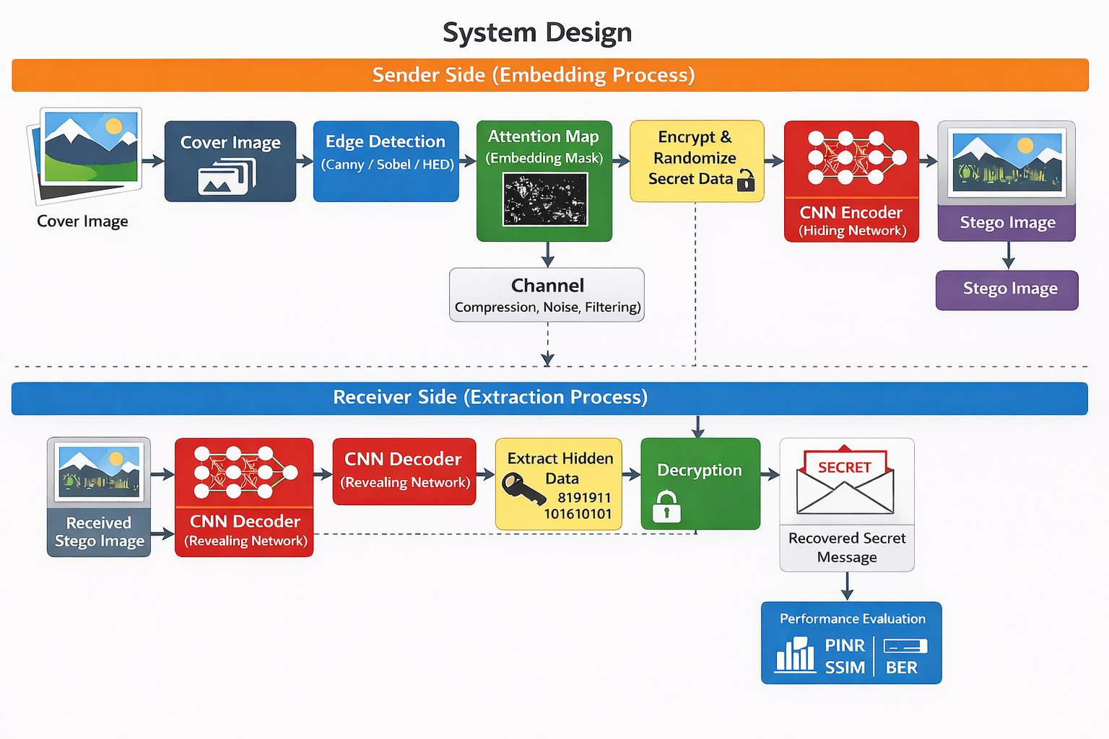
System Design

Slide 13
Dataset Description
To evaluate the proposed Edge Detection + CNN based Image Steganography Framework, standard benchmark image datasets are used to test the system under different image types, textures, and resolutions. The main datasets considered are:
BOSS Base Dataset:
Contains 10,000 grayscale images with a resolution of 512×512. It is widely used as a benchmark dataset in image steganography research for evaluating imperceptibility and steganalysis resistance.
USC-SIPI Dataset:
A standard digitized image dataset containing images of different resolutions such as 256×256, 512×512, and 1024×1024. It is useful for testing the robustness of the steganography model across different image qualities and structures.
Tiny ImageNet Dataset:
Contains 100,000 color images of resolution 64×64 across 200 classes. This dataset provides diverse image content and helps evaluate the generalization ability of the CNN model.
These datasets support effective evaluation of the proposed system using performance metrics such as PSNR, SSIM, and BER, ensuring the framework performs well across different real-world image scenarios.

Slide 14
Software and Hardware Requirements
SOFTWARE REQUIREMENS:
Operating System: Windows 10/11 or Linux
Programming Language: Python
Development Tools: Jupyter Notebook / VS Code / Google Colab
Libraries / Frameworks:
OpenCV (Edge Detection: Canny, Sobel, etc.)
NumPy (Image processing operations)
TensorFlow / PyTorch (CNN model implementation)
Matplotlib (Graphs and evaluation visualization)

Slide 15
Cont…
HARDWARE REQUIREMENS:
Processor (CPU): Intel i5 / i7 or AMD Ryzen 5 / Ryzen 7
RAM: Minimum 8GB (Recommended 16GB)
Storage:
Minimum 20GB free space
SSD recommended for faster dataset loading and training
System Type: 64-bit system
Internet Connection: Required for dataset download and library installation
Input Devices: Keyboard and Mouse (for development and training workflow)
.

Slide 16
Performance Evaluation
PSNR (Peak Signal-to-Noise Ratio)
Measures image quality after embedding; higher PSNR indicates better imperceptibility.
SSIM (Structural Similarity Index)
Evaluates structural similarity between cover and stego images; values closer to 1 indicate high similarity.
MSE (Mean Squared Error)
Measures pixel-level difference; lower MSE means less distortion in the stego image.
BER (Bit Error Rate)
Indicates accuracy of extracted data; lower BER ensures reliable message recovery.
Visual Quality Analysis
Ensures stego image appears identical to original (no visible changes).
Robustness Testing
Evaluated under noise, compression, and filtering to test system reliability.

Slide 17
Conclusion
The proposed system for Robust Image Steganography Using Edge Detection and CNN provides an efficient and secure method for hiding confidential data within digital images. By utilizing edge detection techniques, the system identifies suitable regions for embedding, ensuring that the visual quality of the image remains unaffected. The integration of a CNN-based encoder–decoder model enables intelligent and adaptive data embedding and extraction.
The performance evaluation demonstrates that the system achieves high imperceptibility, strong robustness, and accurate data recovery. Metrics such as PSNR, SSIM, and BER confirm that the stego images maintain quality while securely preserving hidden information. Overall, the approach offers a reliable solution for secure communication and data protection in modern digital environments.

Slide 18
References
Al-Rawashdeh, R., Rahman, M. M., & Niazi, M. (2025).
Robust image steganography approach based on edge detection combined with CNN algorithm. IEEE Access.
Ray, S., Banerjee, S., & Bandyopadhyay, S. K. (2021).
Image steganography using deep learning based edge detection. Multimedia Tools and Applications.
Liu, Q., Tang, Z., & Luo, X. (2020).
Secure and robust image steganography based on convolutional neural networks. IEEE Transactions on Multimedia.
Canny, J. (1986).
A computational approach to edge detection. IEEE Transactions on Pattern Analysis and Machine Intelligence.
Hussain, M., Wahab, A. W. A., Ho, A. T. S., Jung, K. H., & Idris, Y. I. (2018).
Image steganography in spatial domain: A survey. Signal Processing: Image Communication.

Slide 19
Thank You

